Slide 1

Paper Reading（ICLR2020）: A Closer Look at the Optimization Landscapes of Generative Adversarial Networks
Presented by Dachao Lin
Notes:
可视化GAN的training landscape

Slide 2
Outline
Rotation in GANs’ optimization
LNE and LSSP（optimization solution of GAN）
Visualization tool
Experiments

Slide 3
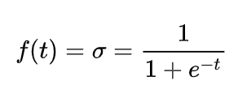


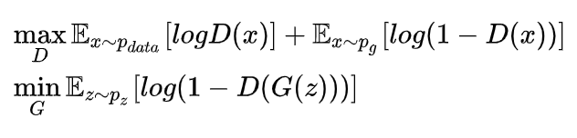
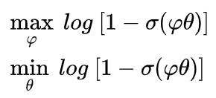
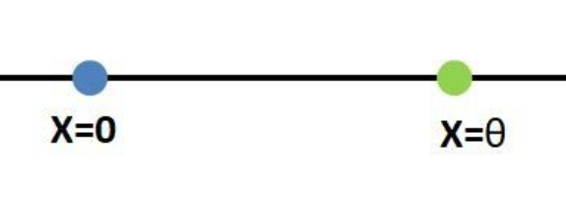
Rotation in GANs’ optimization
Discriminator:
Vanilla GAN
WGAN
Vanilla GAN
Direc GAN
Real sample at x=0, generator parameter , generate data at x= .

Slide 4
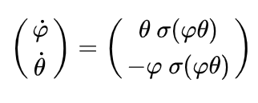
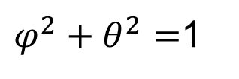
Rotation in GANs’ optimization
Rotation：
Direc GAN
$φ^{2}+θ^{2}=$1
Graident flow
Notes:
注意优化目标一个是min，一个是max，gradient flow对应的符号有差别。

Slide 5
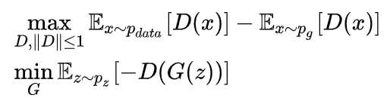
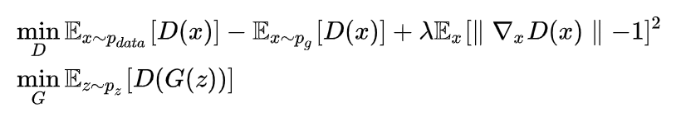
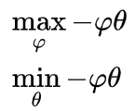
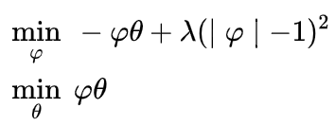
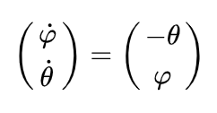
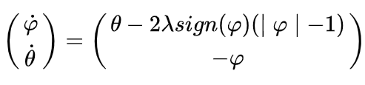
Rotation in GANs’ optimization
WGAN
WGAN-GP
Notes:
WGAN对一阶导数有限制，另外还有简化处理，\phi足够小即可满足约束。
WGAN-GP 合适的参数可以有旋转分量。二阶常系数线性微分方程，特征方程是虚数根。

Slide 6

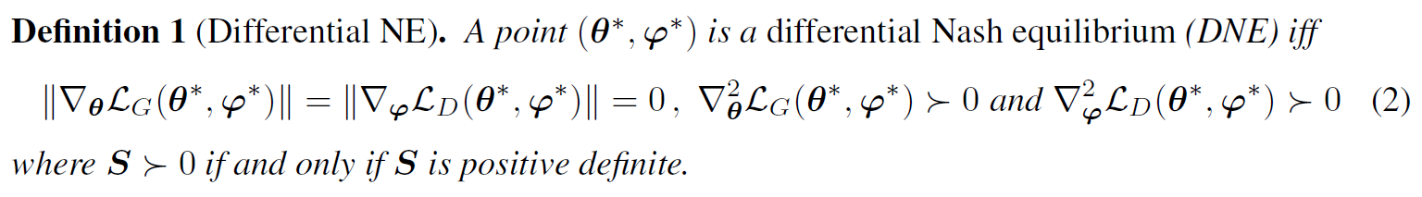
Local Nash Equilibrium (LNE)
Local Nash equilibrium (LNE), i.e. a point only locally true.
Being a DNE is not necessary for being a LNE: a local Nash equilibrium may have Hessians that are only semi-definite.
NE are commonly used in GANs to describe the goal of the learning procedure.
The interaction between the two networks is not taken into account.
Notes:
凸函数考虑NE， 非凸函数考虑LNE。

Slide 7
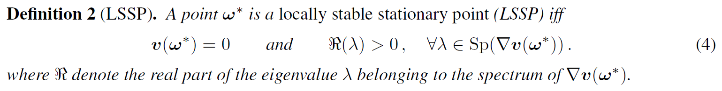
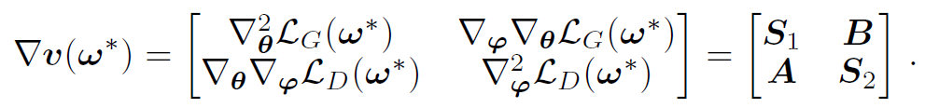
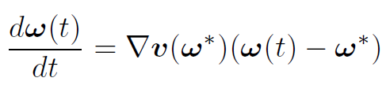


Locally Stable Stationary Point (LSSP)
Intuition:
?
$$≈θ\left(ω\left(t\right)\right)−θ(ω^{∗})$$
Notes:
Jacobian of the game vector field.

Slide 8
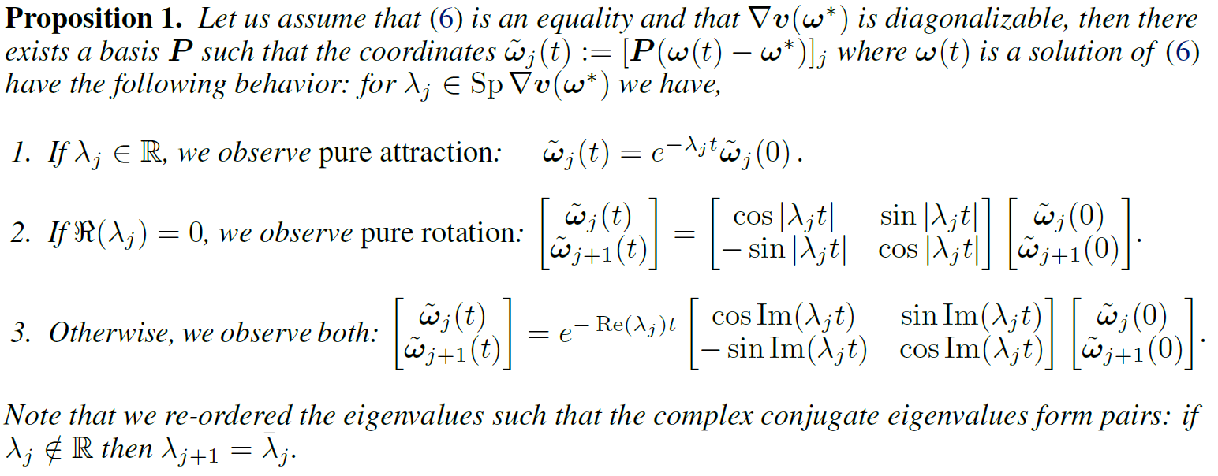
Locally Stable Stationary Point (LSSP)
Notes:
实部大于零总能收敛。

Slide 9
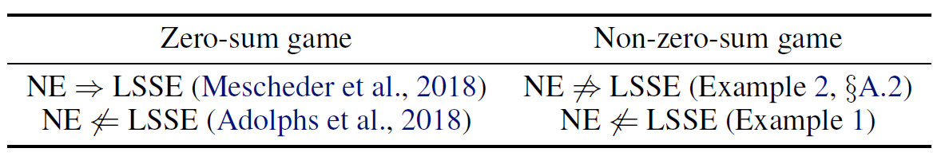
LSSP ≠ LNE

Slide 10
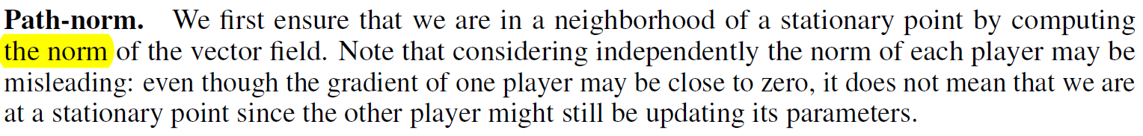
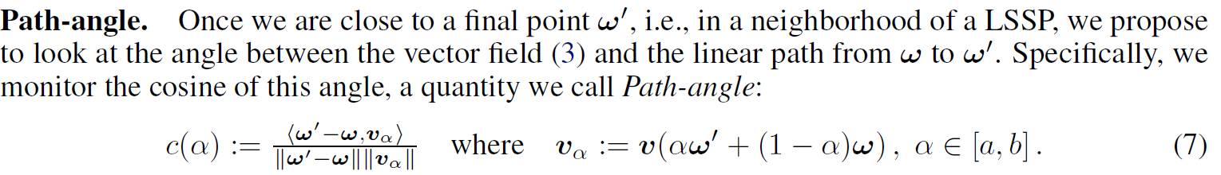

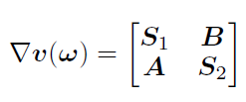
Visualization tool

Slide 11
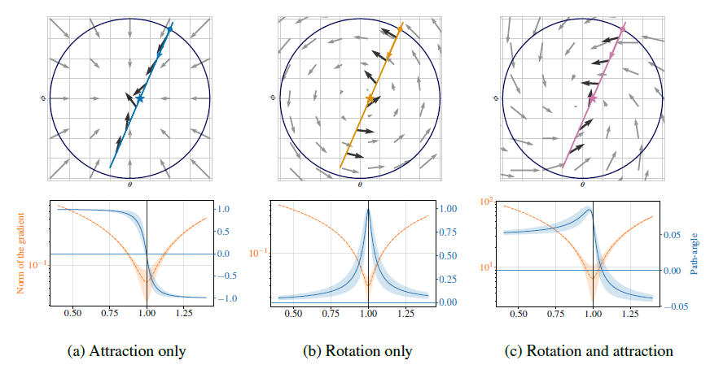
Visualization tool
Notes:
横纵坐标
Angle：有尖峰就有旋转分量。

Slide 12
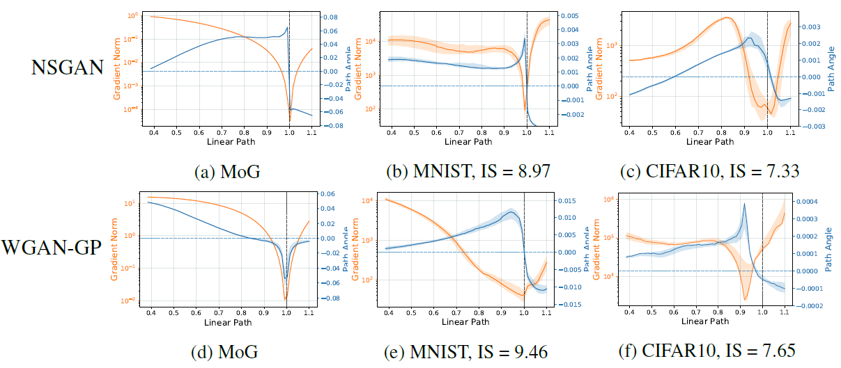
Path-angle for NSGAN (top row) and WGAN-GP (bottom row)

Slide 13
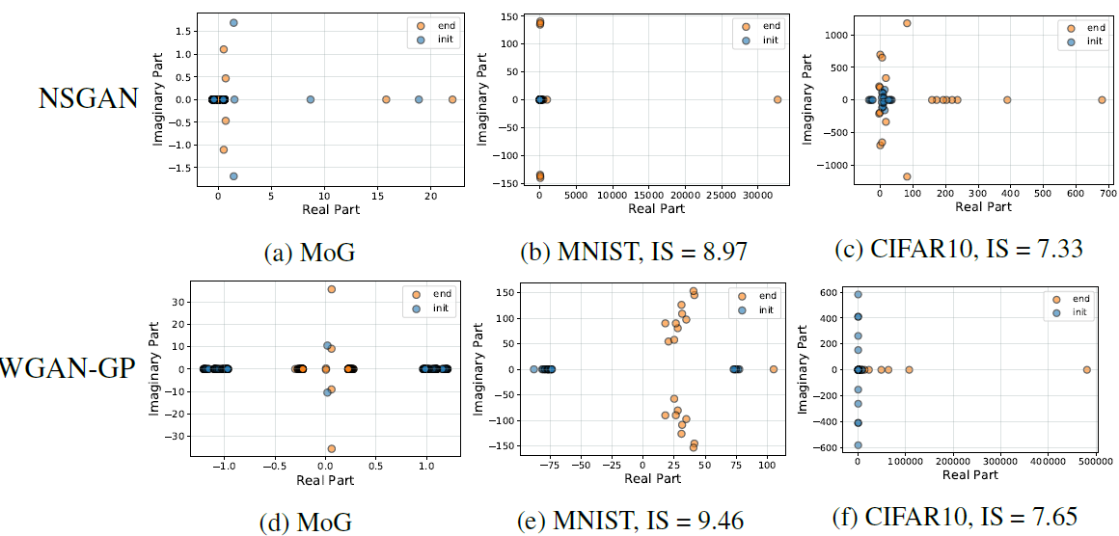
Eigenvalues of the Jacobian of the game for NSGAN (top row) and WGAN-GP (bottom row)

Slide 14
Summary
The rotational component is clearly visible.
The complex eigenvalues for NSGAN seems to be much more concentrated on the imaginary axis ???
WGAN-GP tends to spread the eigenvalues towards the right of the imaginary axis ???
Notes:
WGAN-GP performs slightly better than NSGAN. 旋转成分实部更小。

Slide 15
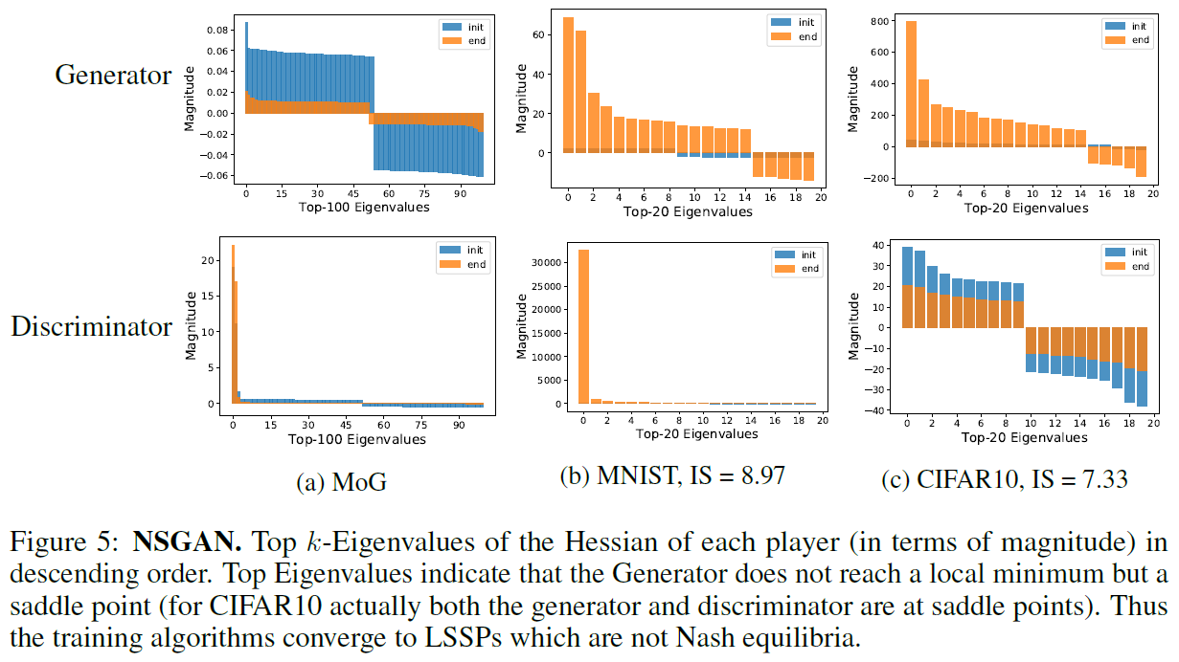
Top k-Eigenvalues of the Hessian of each player
Notes:
Discriminator 正定

Slide 16
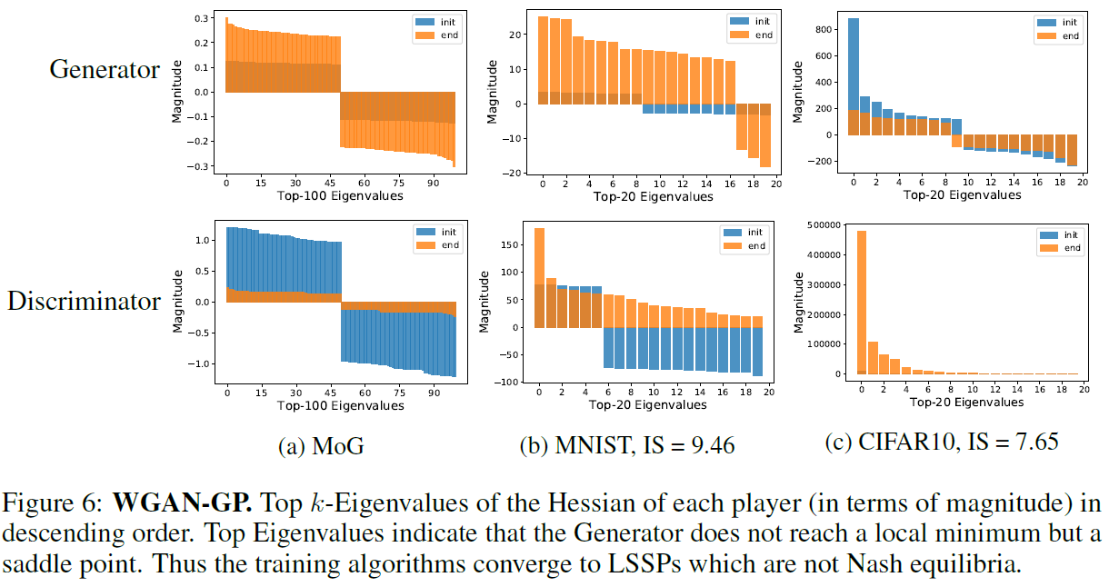

Slide 17
Summary
The generator never reaches a local minimum but instead finds a saddle point.
The algorithm converges to a LSSP which is not a LNE.
NSGAN converges to a solution with very large positive eigenvalues compared to WGAN-GP.
The gradient penalty acts as a regularizer on the discriminator and prevents it from becoming too sharp.

Slide 18
Discussion
GANs do not converge to local Nash Equilibria.
The optimization landscapes of GANs typically have rotational components.
Whether we need a Nash equilibrium to get a generator with good performance in GANs?
Handle strong rotational components:
extragradient, averaging, gradient penalty based…

